Slide 1

Hearing through haptics
A Planar, Audio-spatial Awareness Device
A WPI Major Qualifying Project by
Colin Ancalmo, Amani Campbell, Yifan Liu, James Van Tronk, Emily Wood
Advised by
Professor Joe Stabile

Slide 2
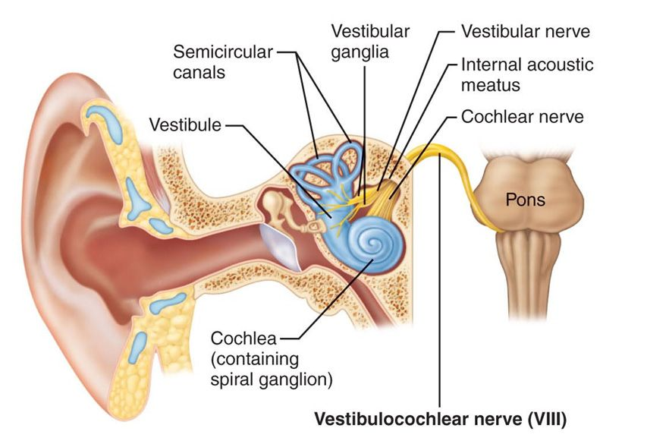
Problem statement
Vestibulocochlear nerve
466 Million cases of disabling hearing loss world wide. Expected to double by 2050 (WHO, 2020)
Existing assistive devices are limited

Slide 3

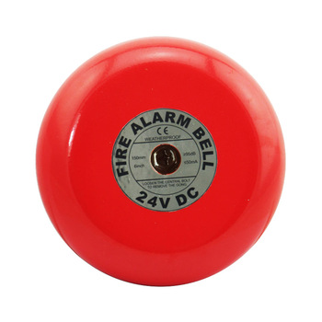
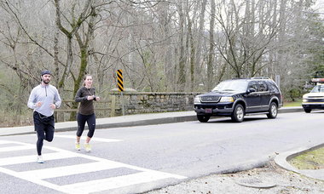


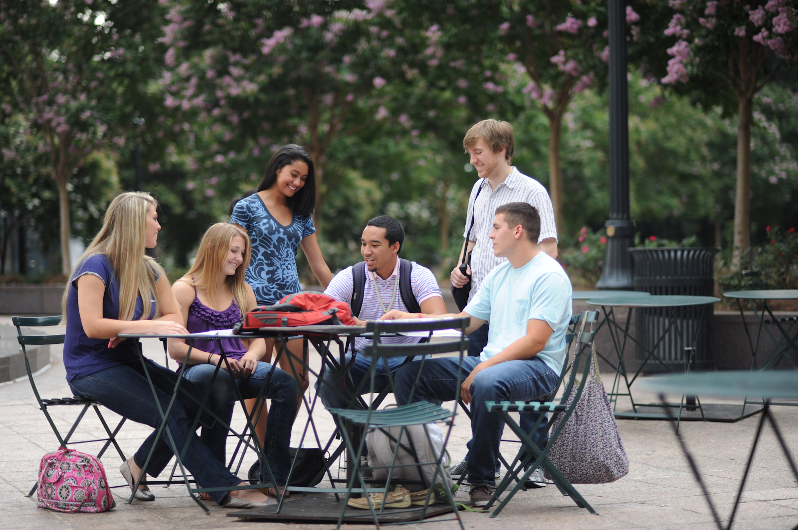
Haptic audio assistive device
Independent of the vestibular nerve
Non-invasive, wearable and planar
Utilize haptic feedback to the indication direction of sounds
Urgent safety alerts
Social interactions
Fire Alarms, Vehicle Honks & Sirens
Voices Directed Toward You

Slide 4
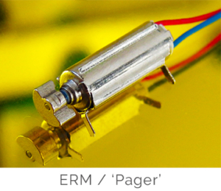
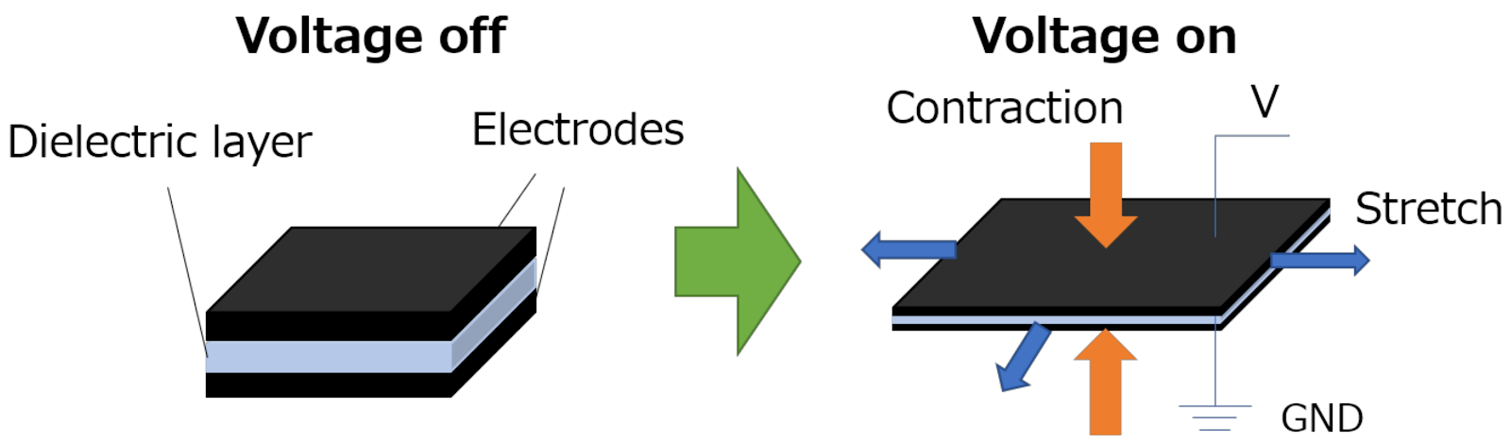
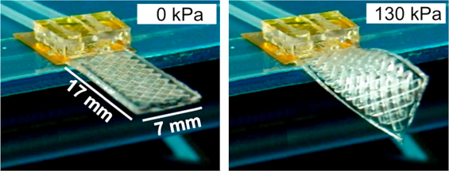
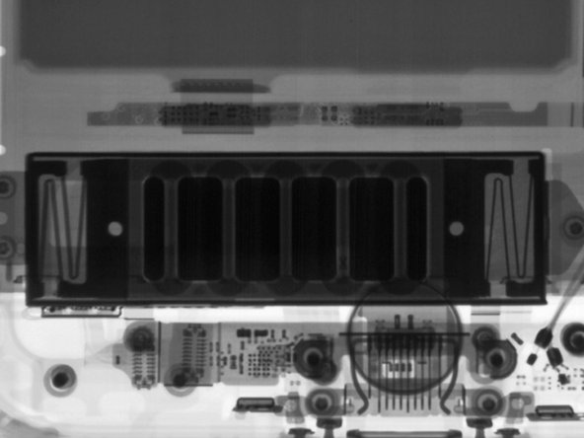
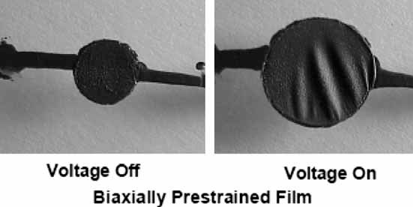
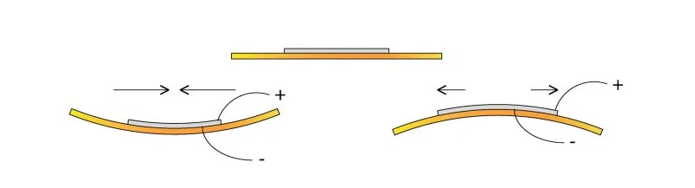
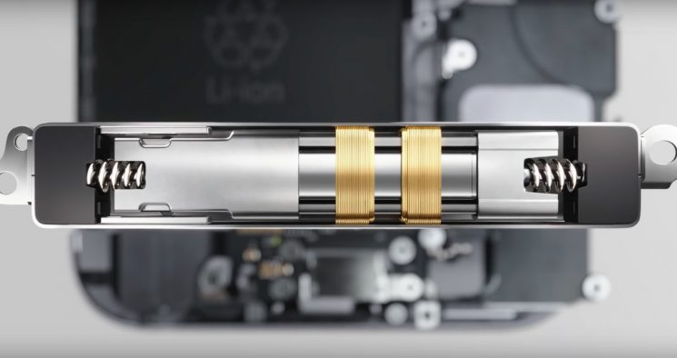
Haptic mechanisms
Magnet and coil
Dielectric ELASTOMERS
INVERSE PIEZOS

Slide 5
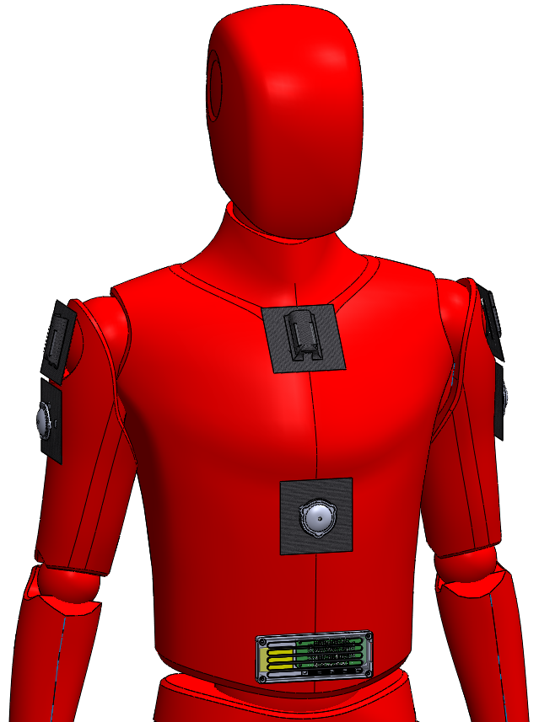
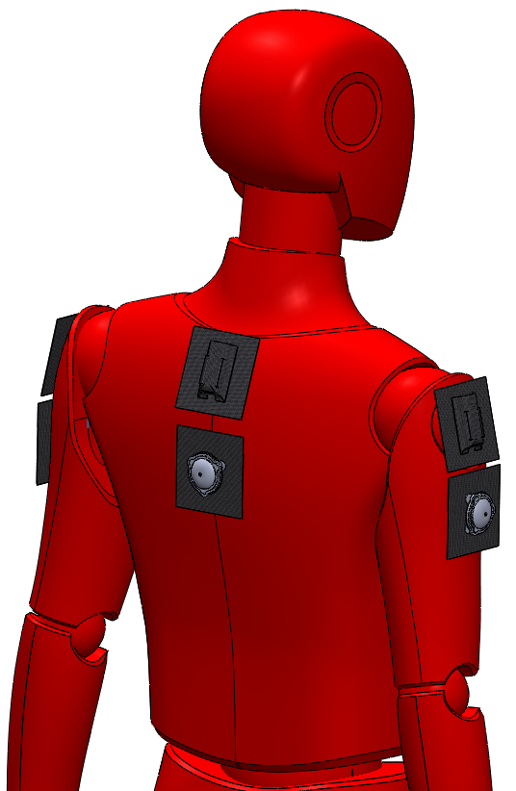
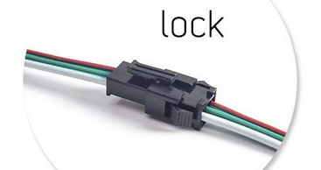
Wearable design
Microphones
Ribbon Cables
Planar Actuators
Electrical Housing

Slide 6
01
Mechanical design

Slide 7
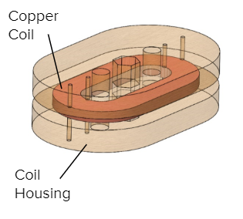
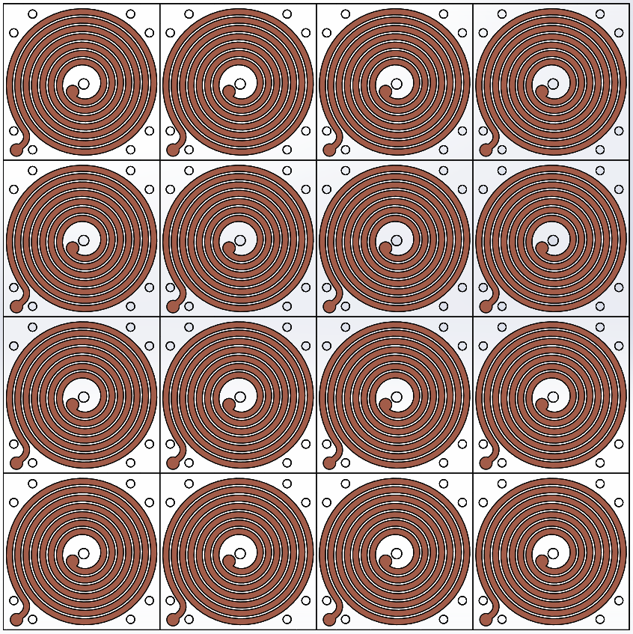
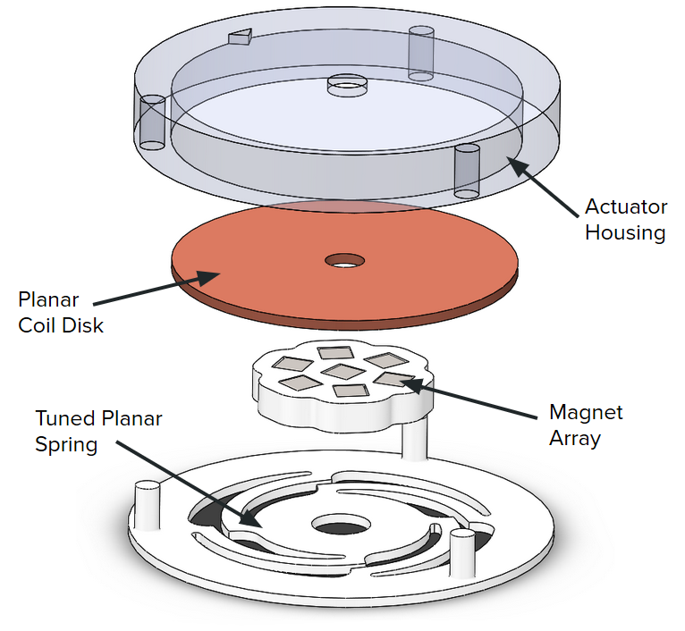
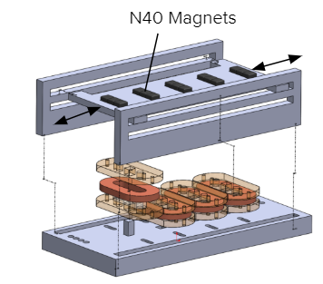
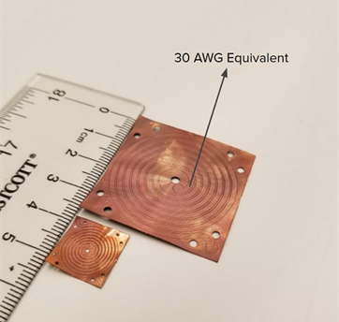
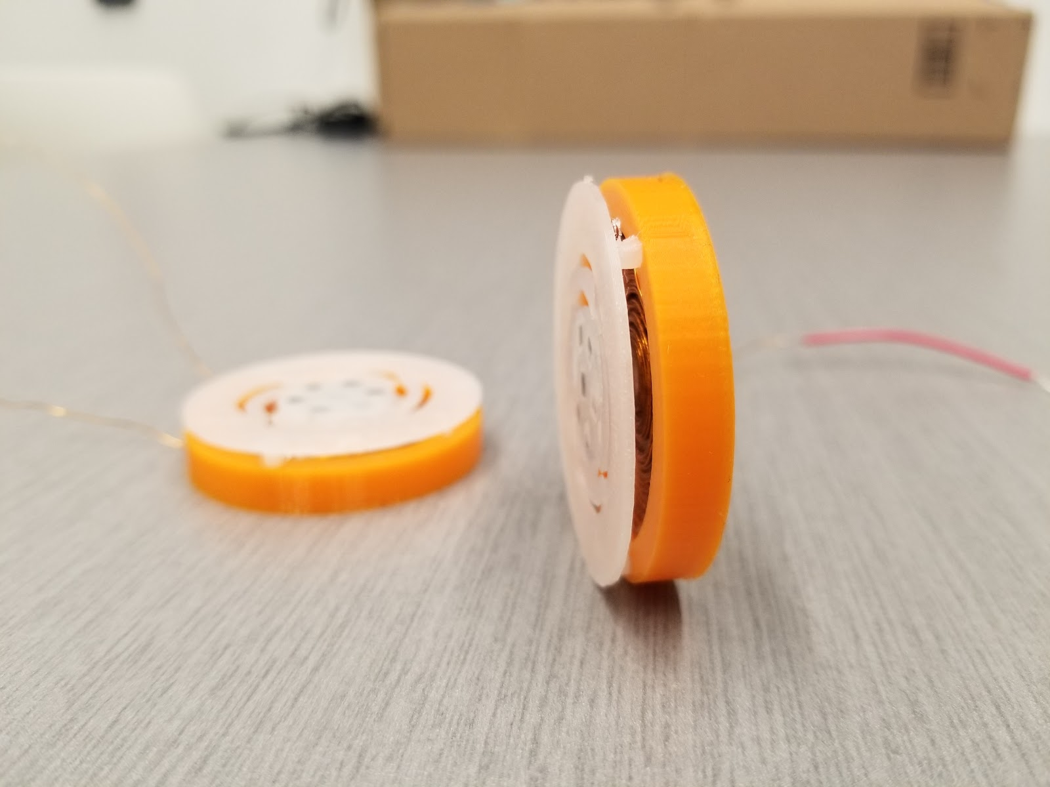
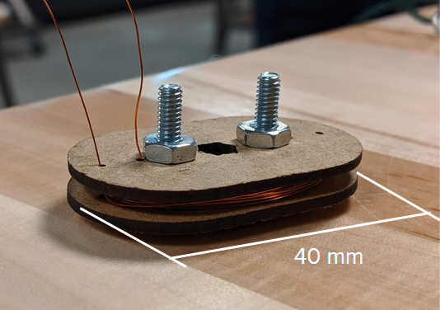
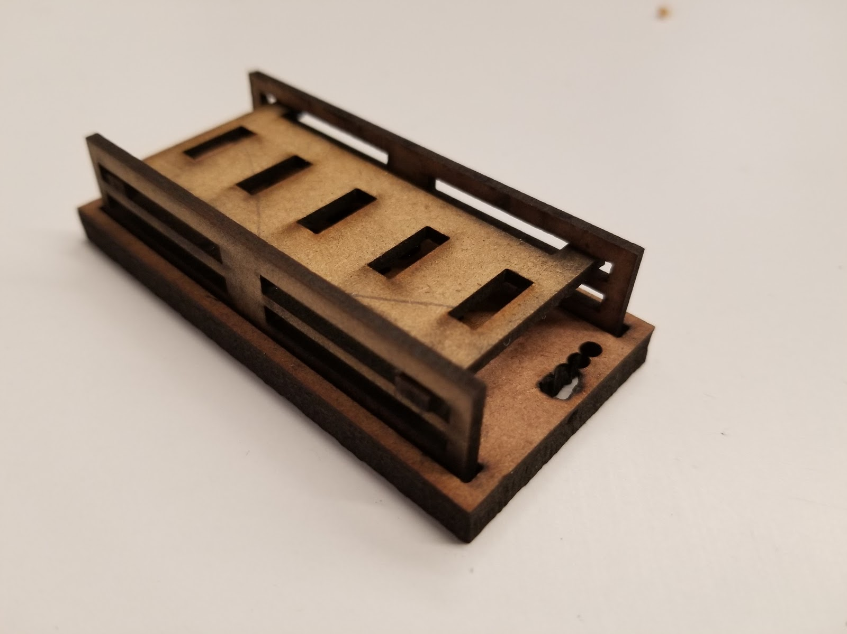
Actuator design development
Race track
Flexible pyralux
Planar coil disk
z

Slide 8
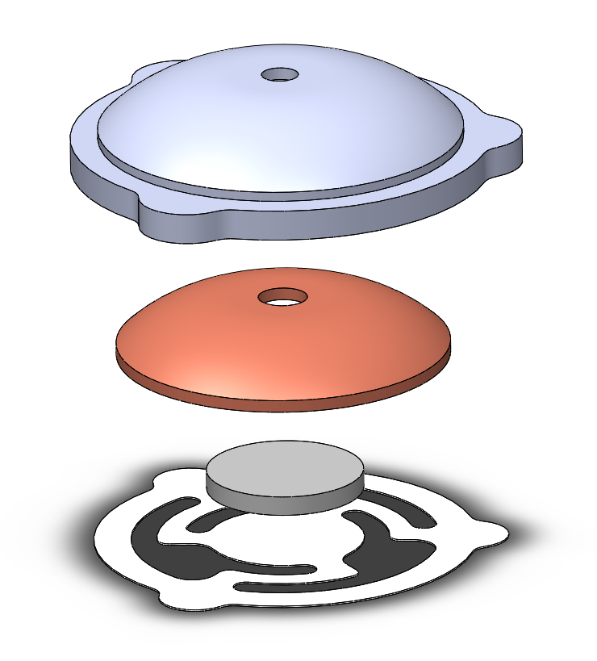
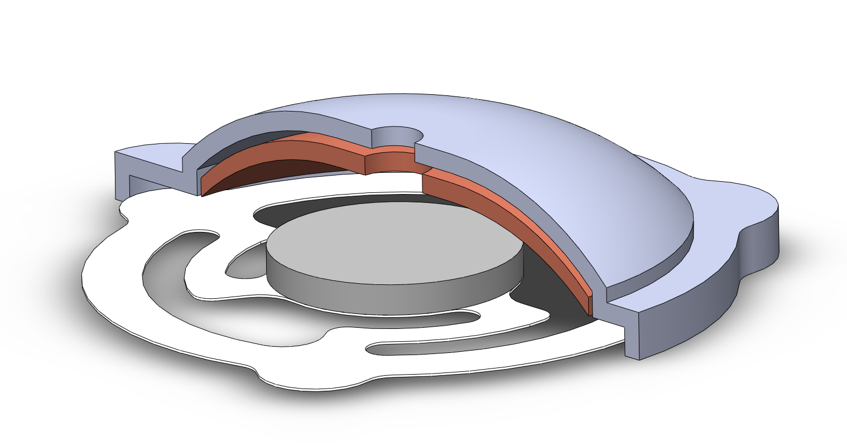
Final dome cad assembly
Glue Bond
3D Printed Coil Spring Housing (PLA)
Formed Dome Coil (178 Turns, 30 AWG)
Disk Magnet
(N40)
Turned Planar Spring (1095 Spring Steel)

Slide 9
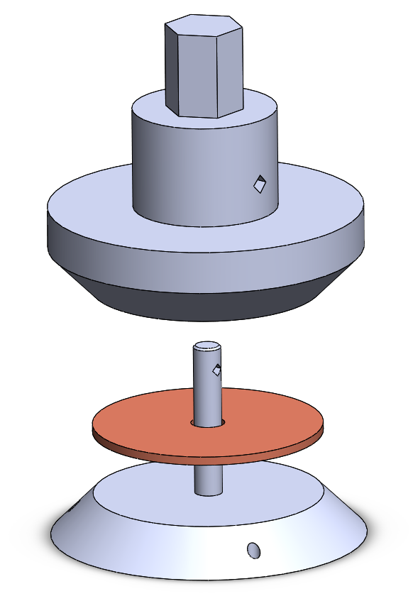
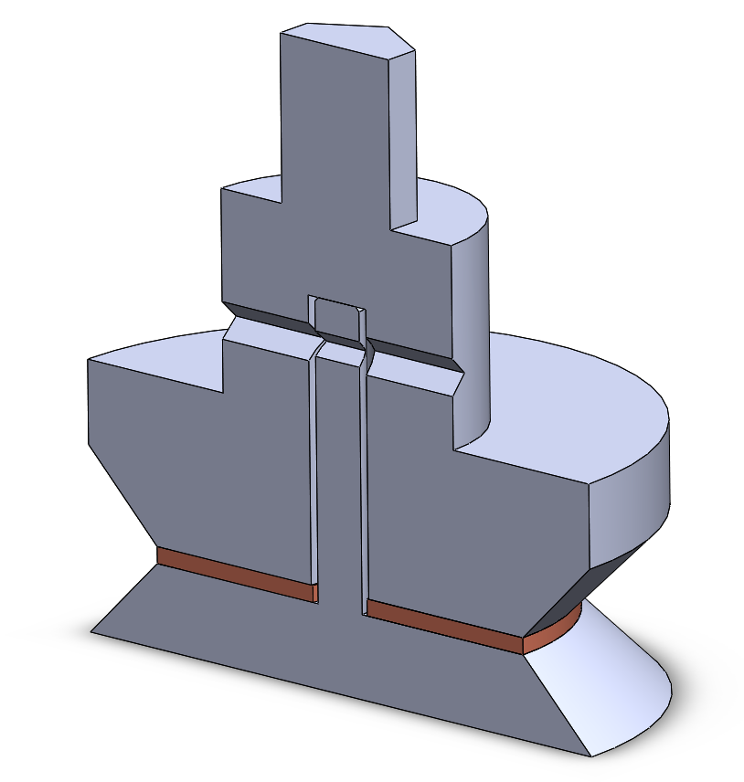
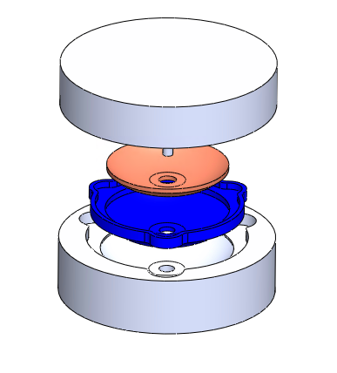
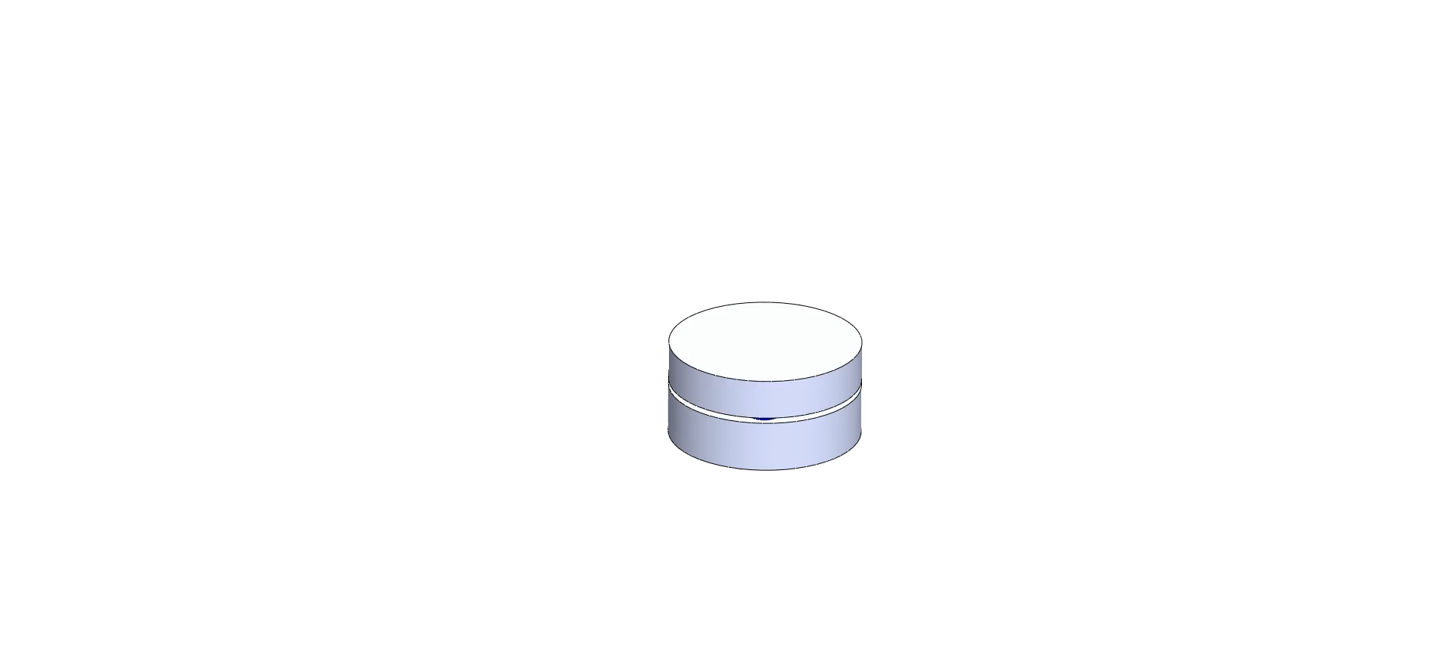

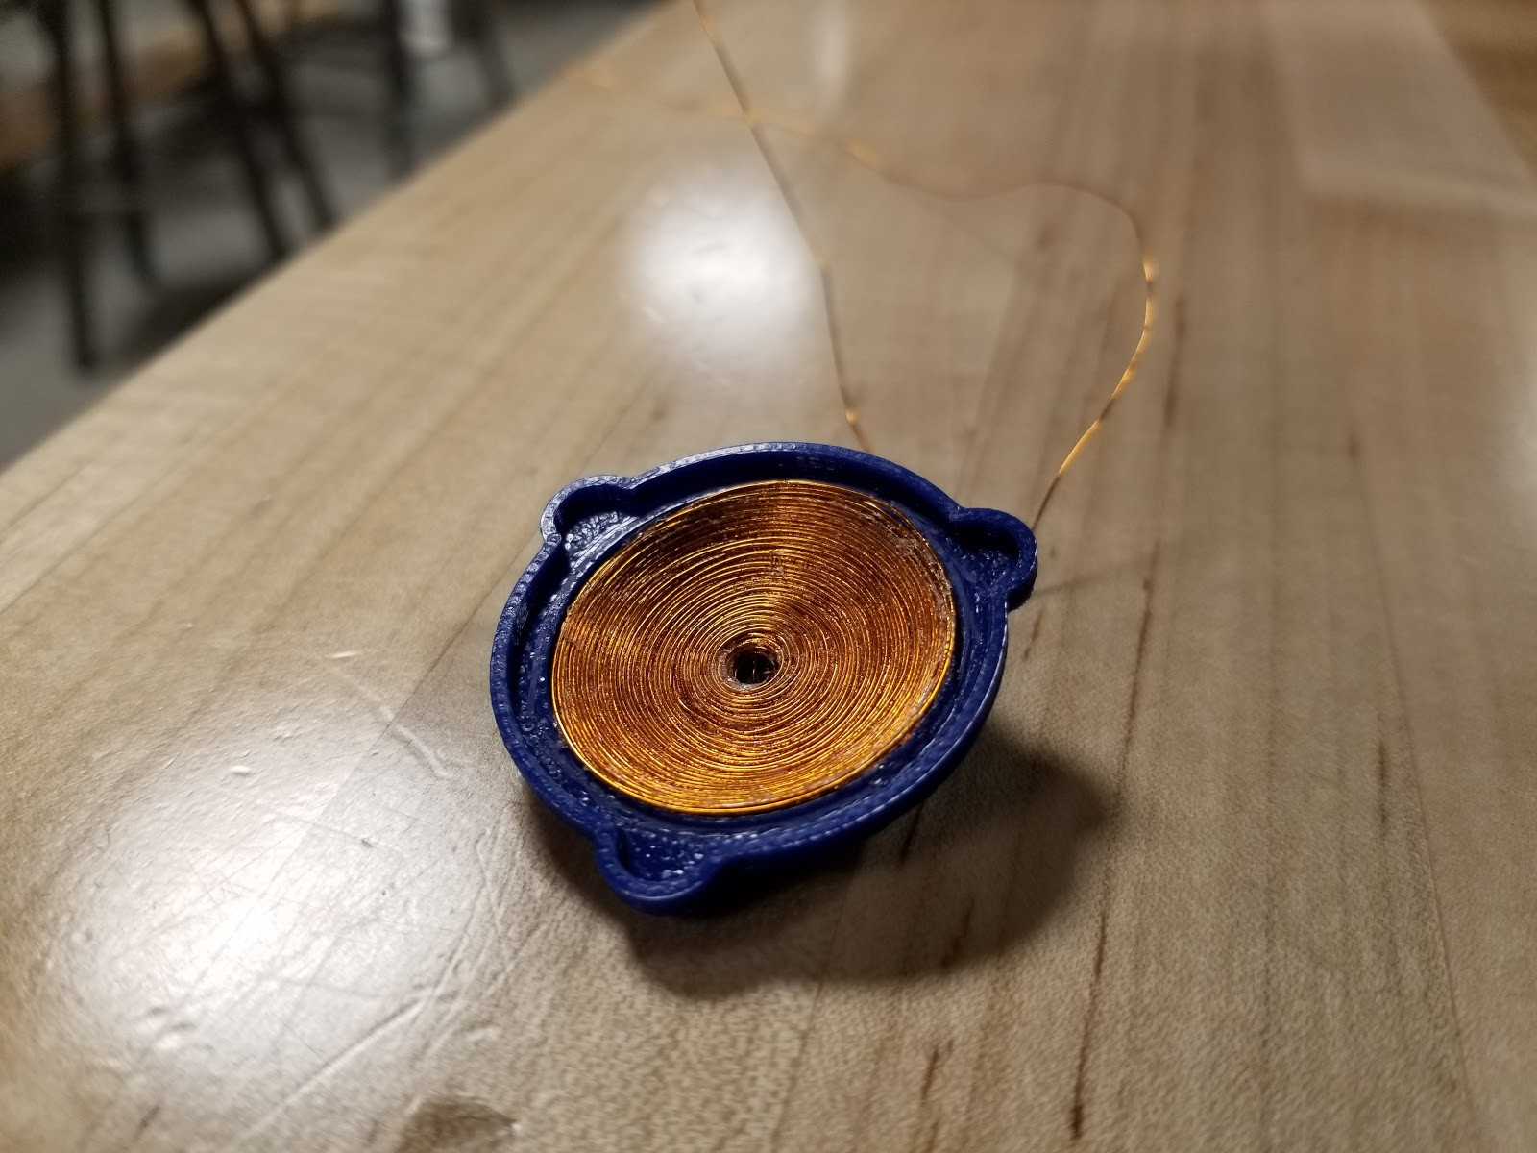
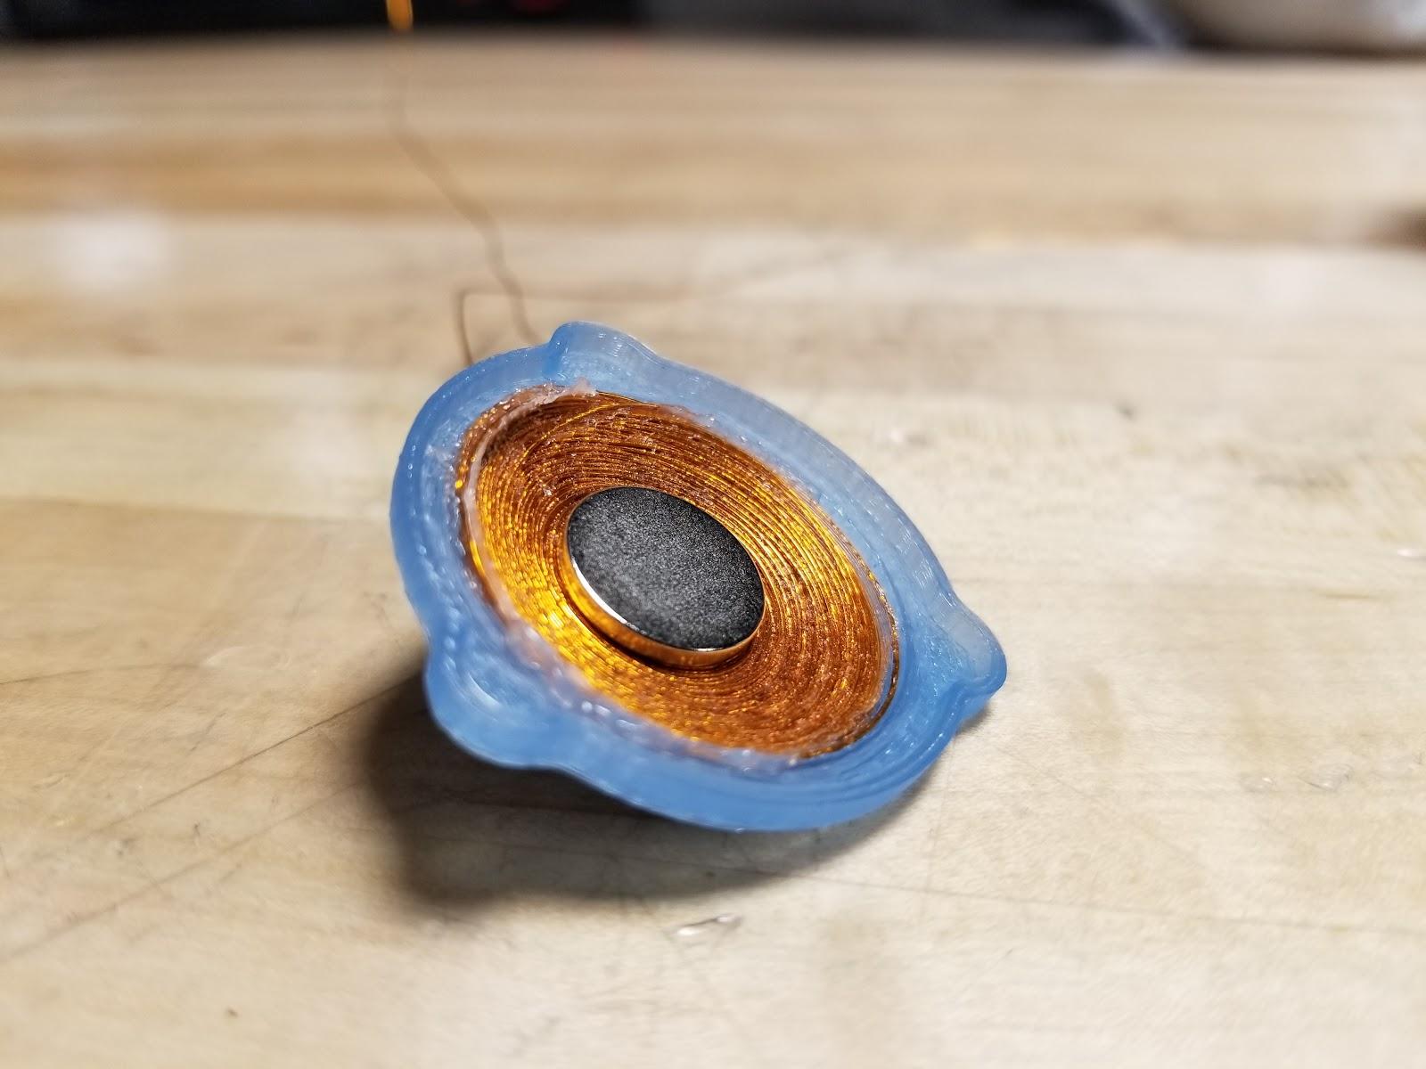
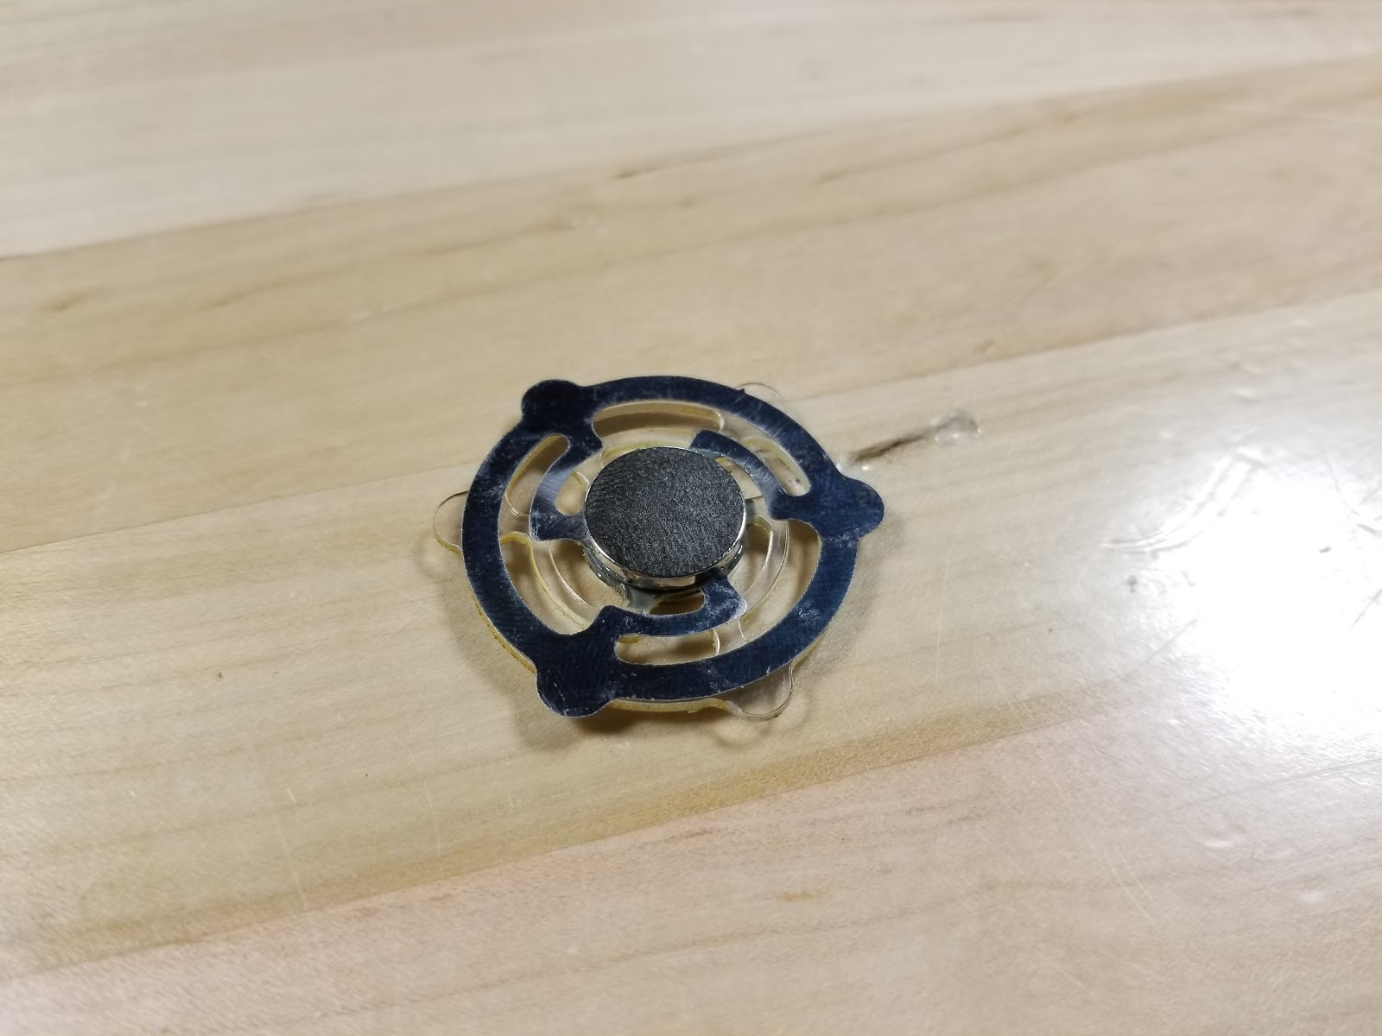
HARDWARE FABRICATION
Hitch Pin
Copper Coil

Slide 10
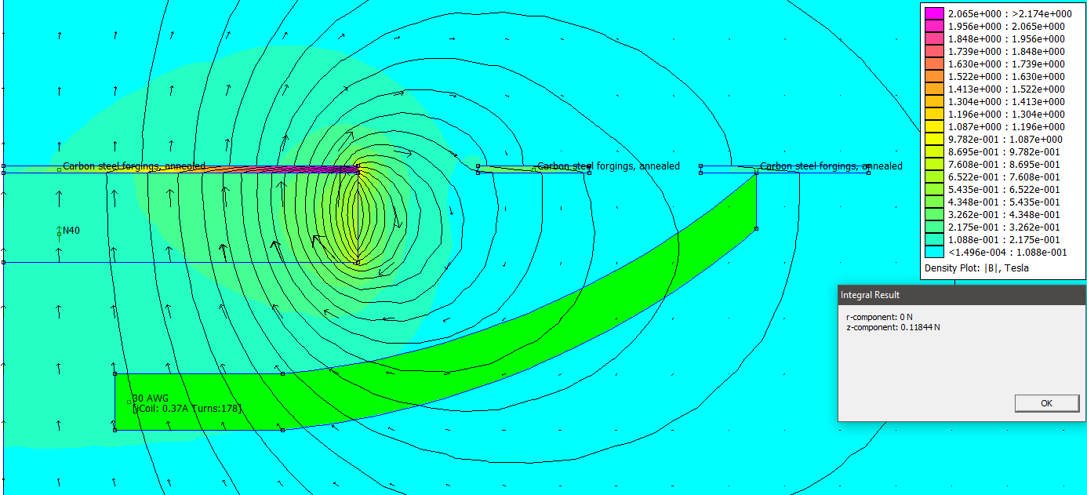
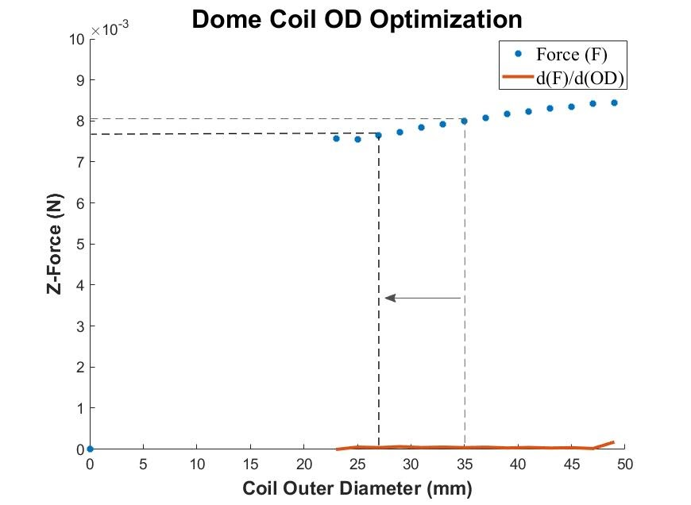
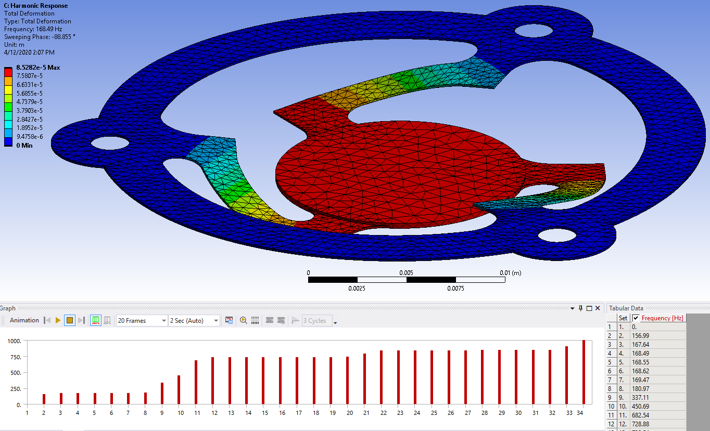
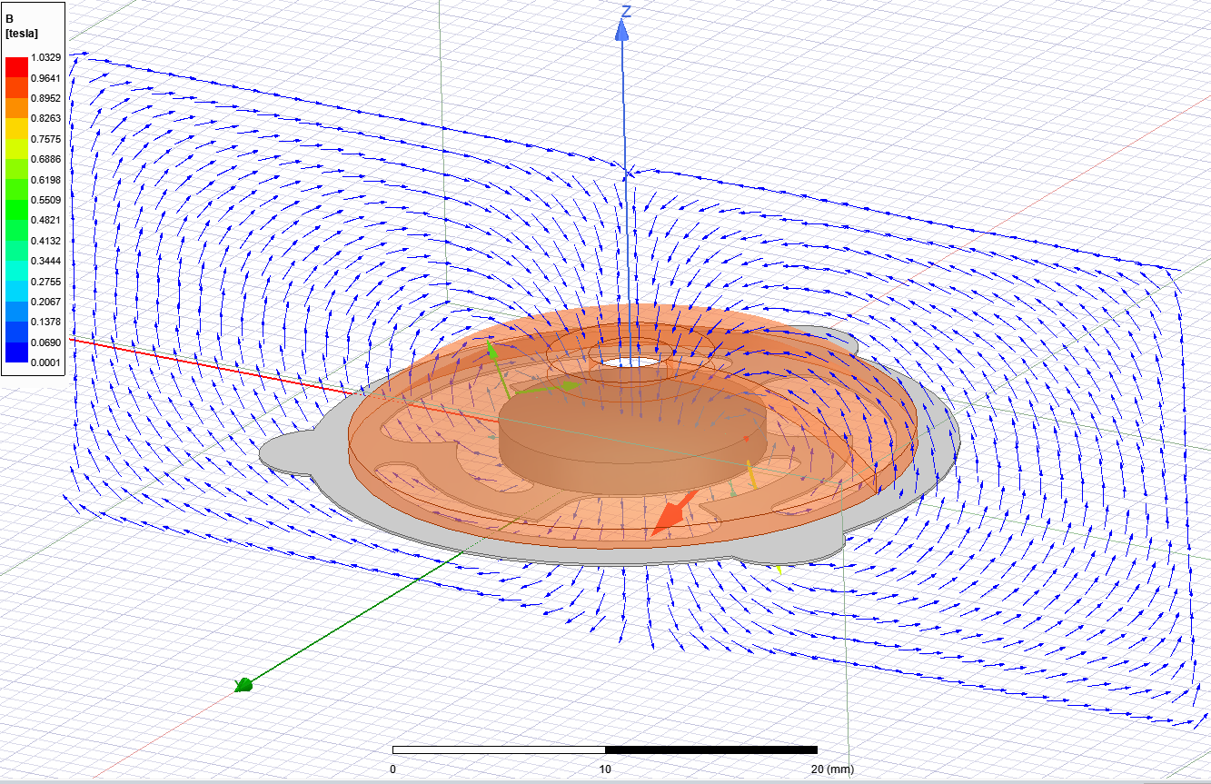
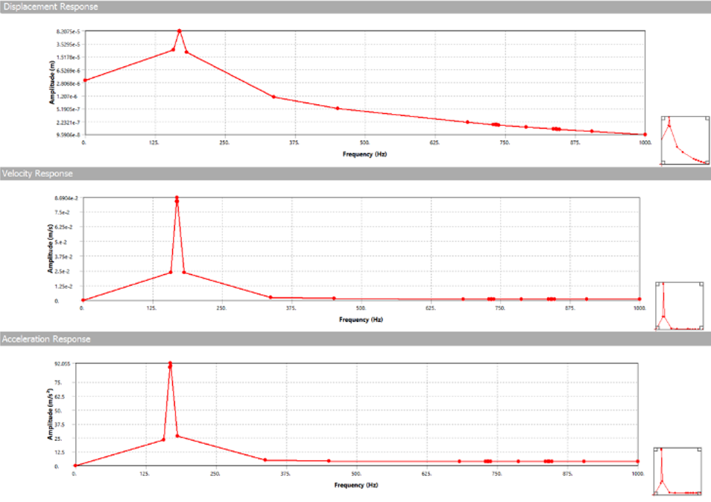
Final actuator analysis
Magnetic, harmonic, force
Inertial force output at steady state resonance:
F_{avg} = 0.0442N
Magnetic: F_{ln} = 0.0068 N
Final Coil Diameter: 27mm
Resonant Frequency: 169 Hz

Slide 11
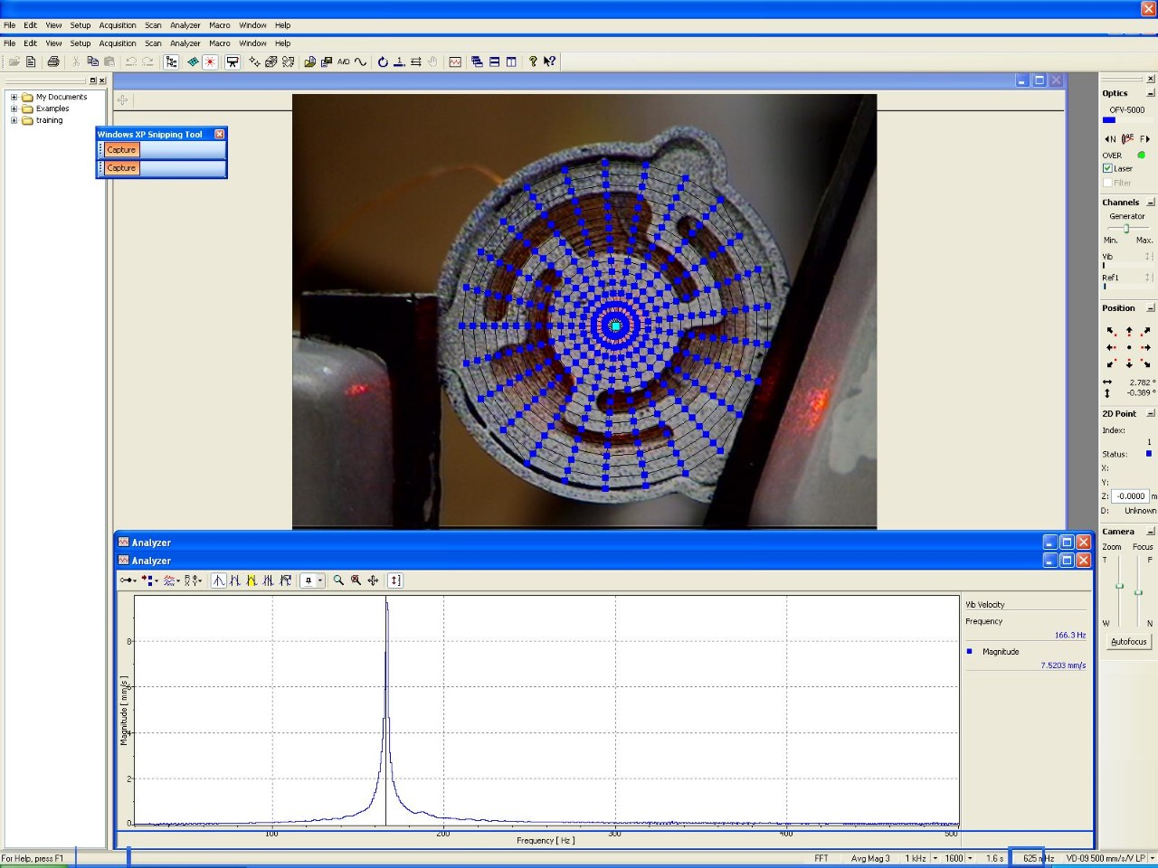
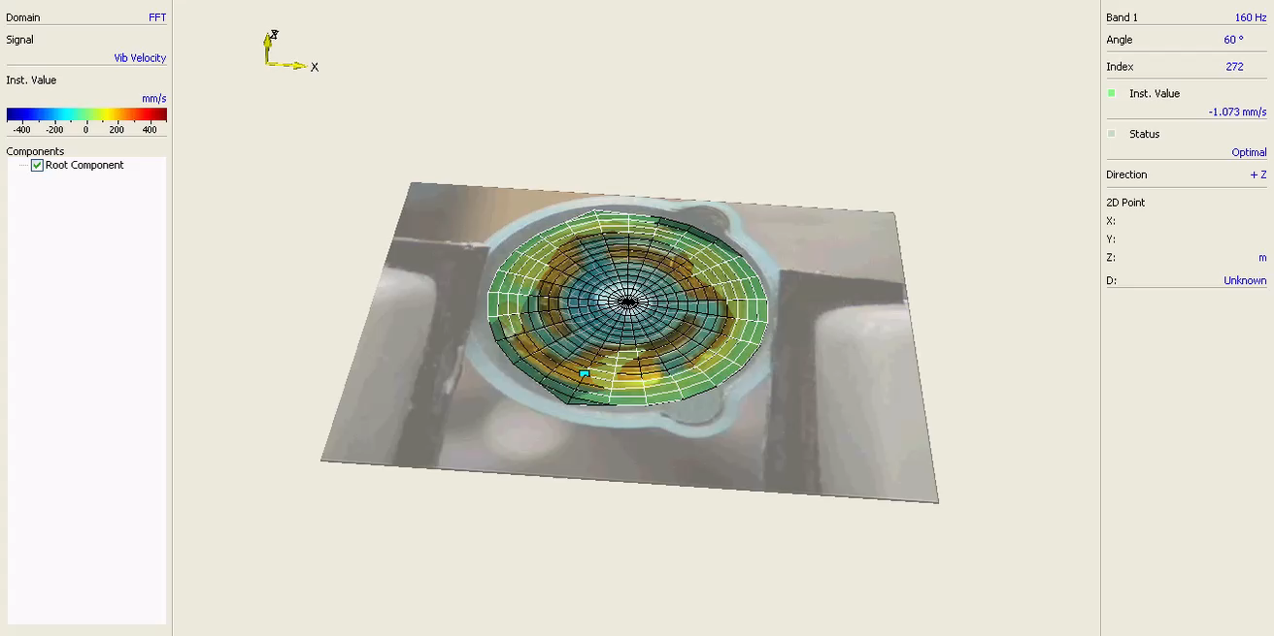
Resonance Validation
Expected M1 Resonance: 169 Hz
Measured M1 Resonance:166 Hz

Slide 12
02
electrical design

Slide 13
Wearable design
Microphones
Ribbon Cables
Planar Actuators
Electrical Housing

Slide 14
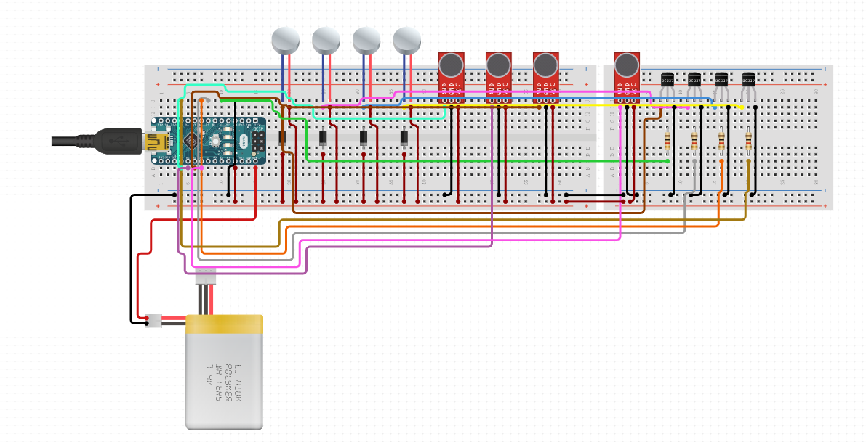
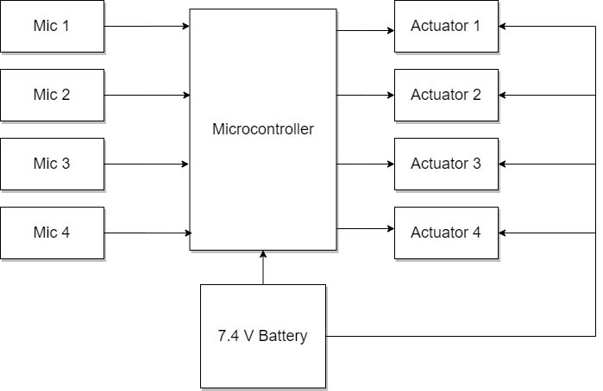
AUDIO SENSING AND PROCESSING
Input
Sound
Processing
Output
Vibration
Notes:
We have a block diagram of how our system operates: We take in sound as our input through the microphones

Slide 15
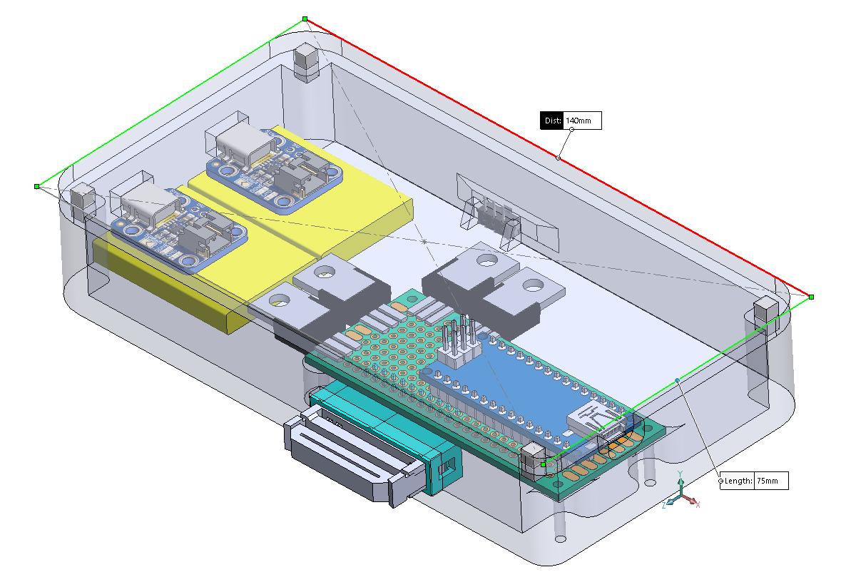
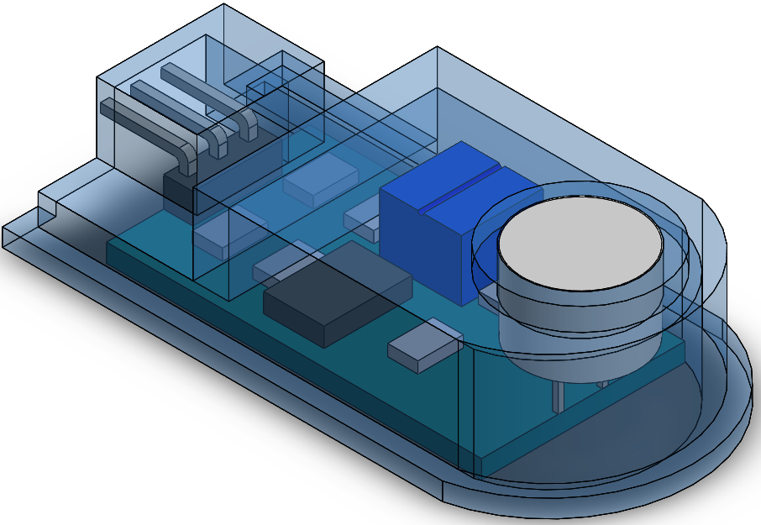
Electrical hardware
circuit housing
Microphone housing

Slide 16
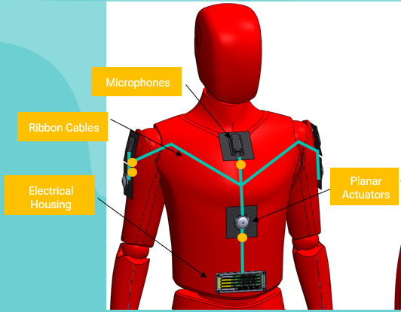
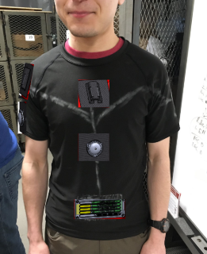
Future work

Slide 17
Acknowledgements
Our Advisor: Joe Stabile
Foisie Innovation Studio Makerspace: Mitra Anand
Washburn Shops
Bose Corporation Makerspace: Dan Sheehan and Carl Kallgren
ECE Students: Tahvorn George and Fivos Kavassalis
ME Department: Barbara Furham

Slide 18
Thank you!
cancalmo@wpi.edu
aacampbell@wpi.edu
jrvantronk@wpi.edu
yliu21@wpi.edu
eswood@wpi.edu

