Slide 1


BOSTON COTTON
THE “WISPO”
Julian Nyland, Kyle Foley, Nicholas Albert, Amani Campbell
Notes:
Amani - everyone introduce themselves

Slide 2
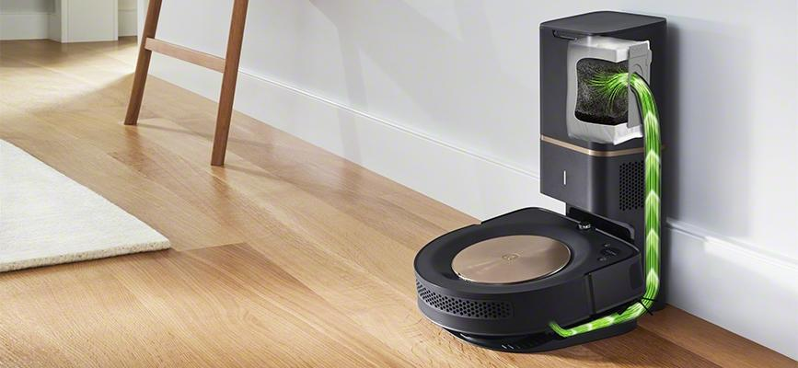
PROBLEM
Test Clean Base performance by quickly and efficiently filling bins with debris
Clean Base Automatic Dirt Disposal system
Notes:
Julian

Slide 3
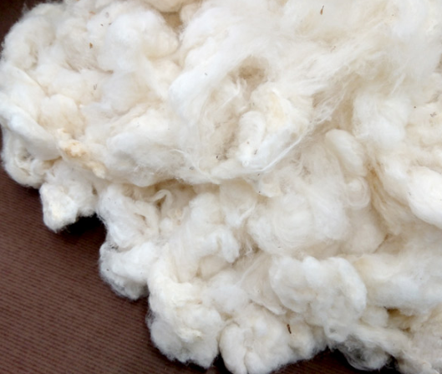
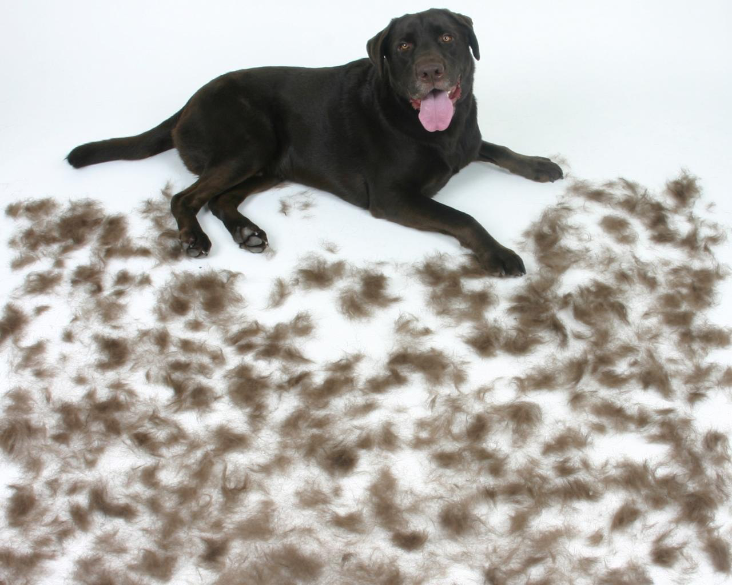
SOLUTION
Create a device that turns bulk cotton into small fibers, dispensing them onto a conveyor belt, to simulate hair on a carpet
Notes:
Julian

Slide 4
KEY FEATURES TO SOLUTION
COMPRESSED
AIR
CENTRIPETAL FORCE
FLEXIBLE BRUSH
Notes:
Nicholas

Slide 5
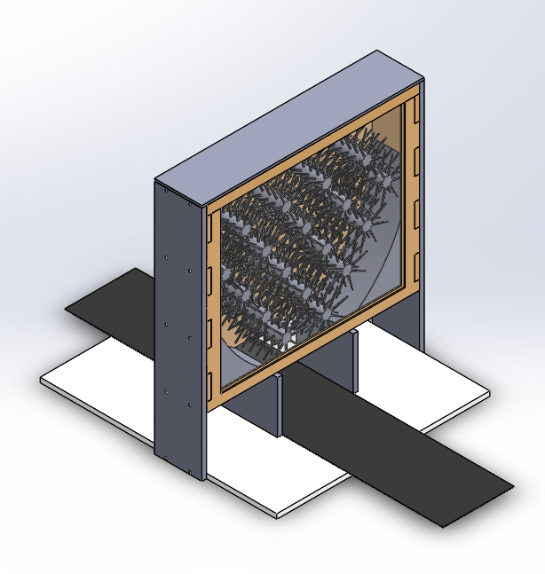
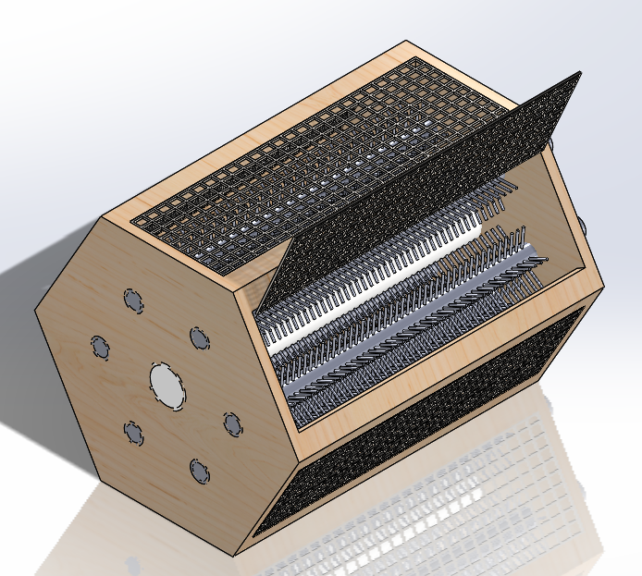
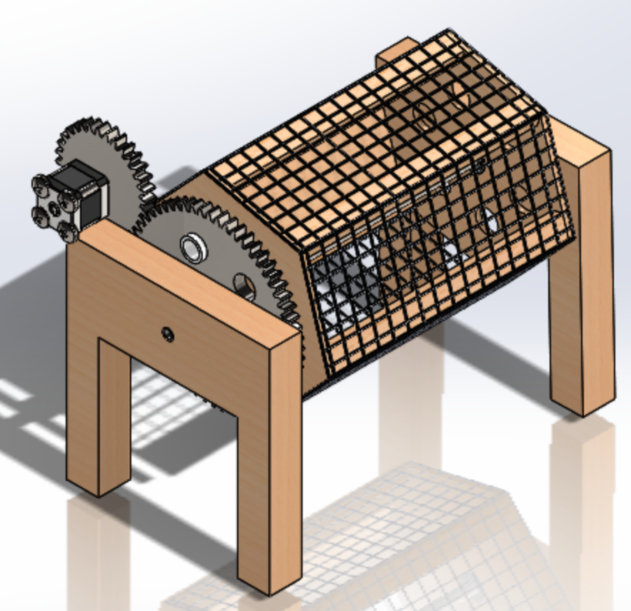
EVOLUTION
Notes:
KYLE

Slide 6
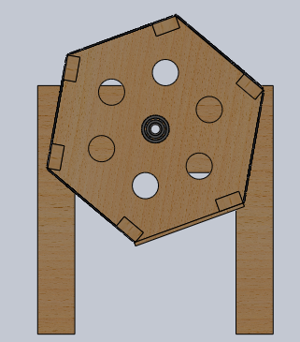
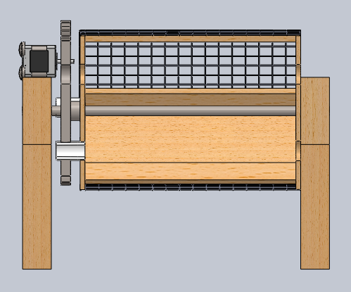
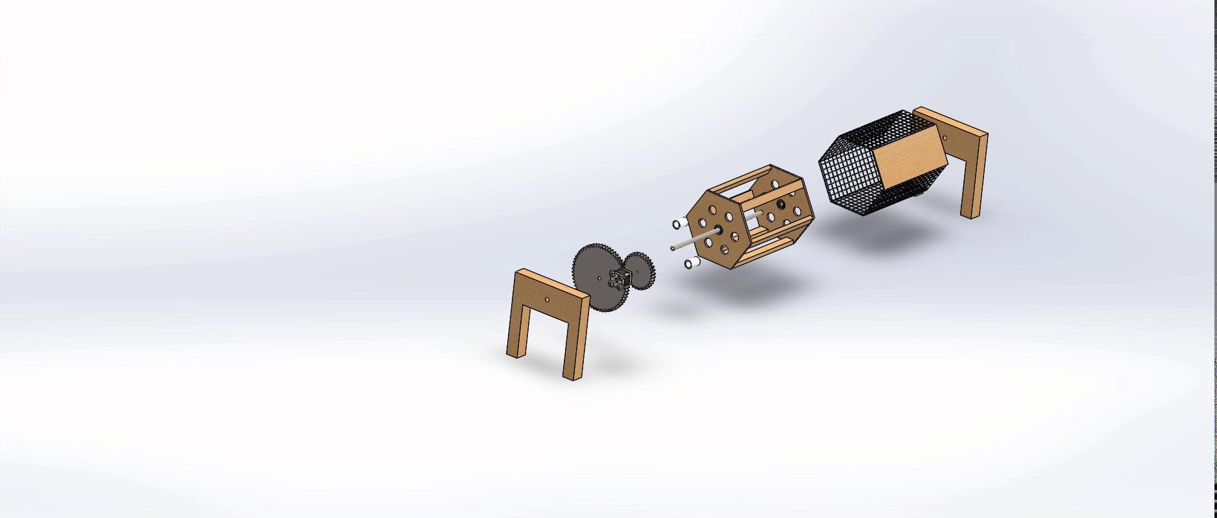
FINAL DESIGN
SECTION VIEWS
EXPLODED VIEW
Notes:
AMANI

Slide 7
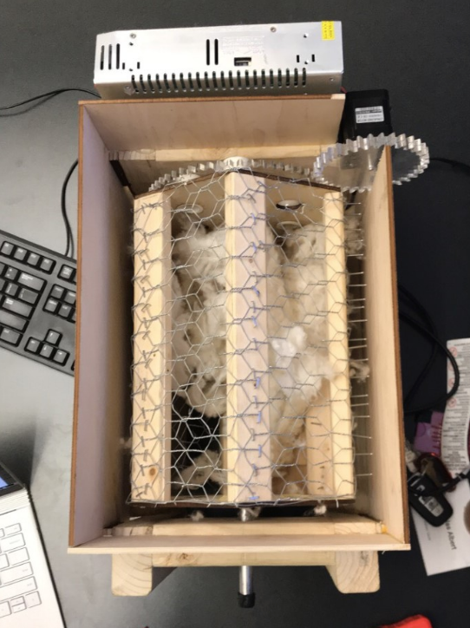
FLOW OF MATERIAL
Outer casing catches debris, slides to conveyor belt at bottom
Notes:
JULIAN

Slide 8
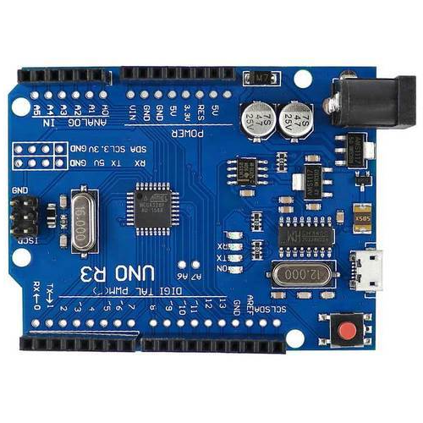
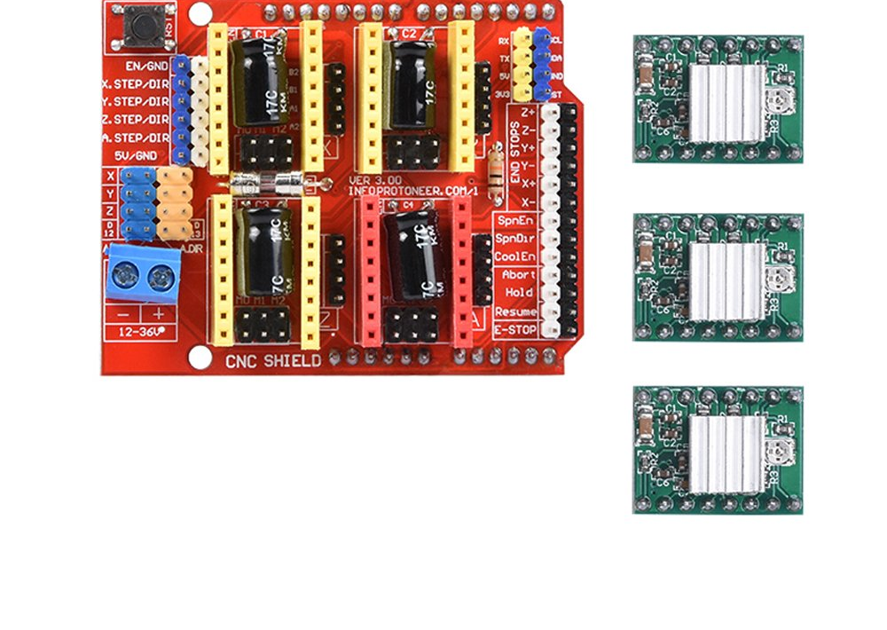
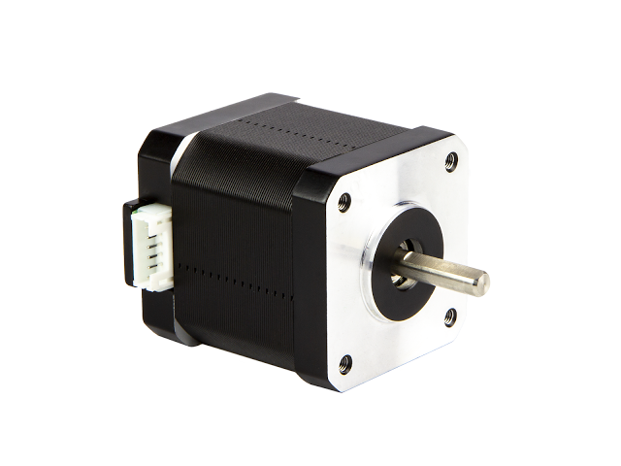
ELECTRICAL DESIGN
12V DC supply
Computer
Notes:
AMANI

Slide 9
ARDUINO CODE
#define EN 8
//Direction pin
#define DIR 5
//Step pin
#define STEP 2
double delayTime = 40; // Calculate rpm through delay time
void setup() {
pinMode(DIR, OUTPUT);
pinMode(STEP, OUTPUT);
pinMode(EN, OUTPUT);
digitalWrite(EN, LOW);
digitalWrite(DIR, true);
}
void loop(){
// 166.67 is about 60 rpm
digitalWrite(STEP, HIGH);
delayMicroseconds(delayTime);
digitalWrite(STEP, LOW);
delayMicroseconds(delayTime);
}

Slide 10
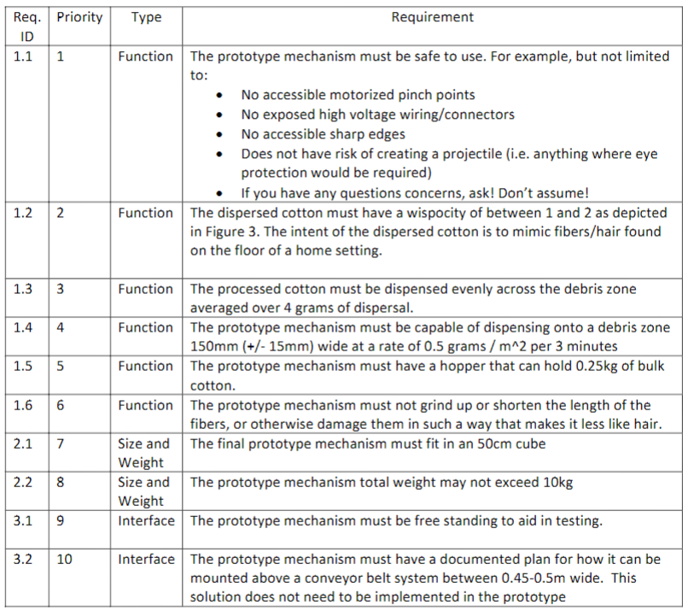
Notes:
JULIAN

Slide 11
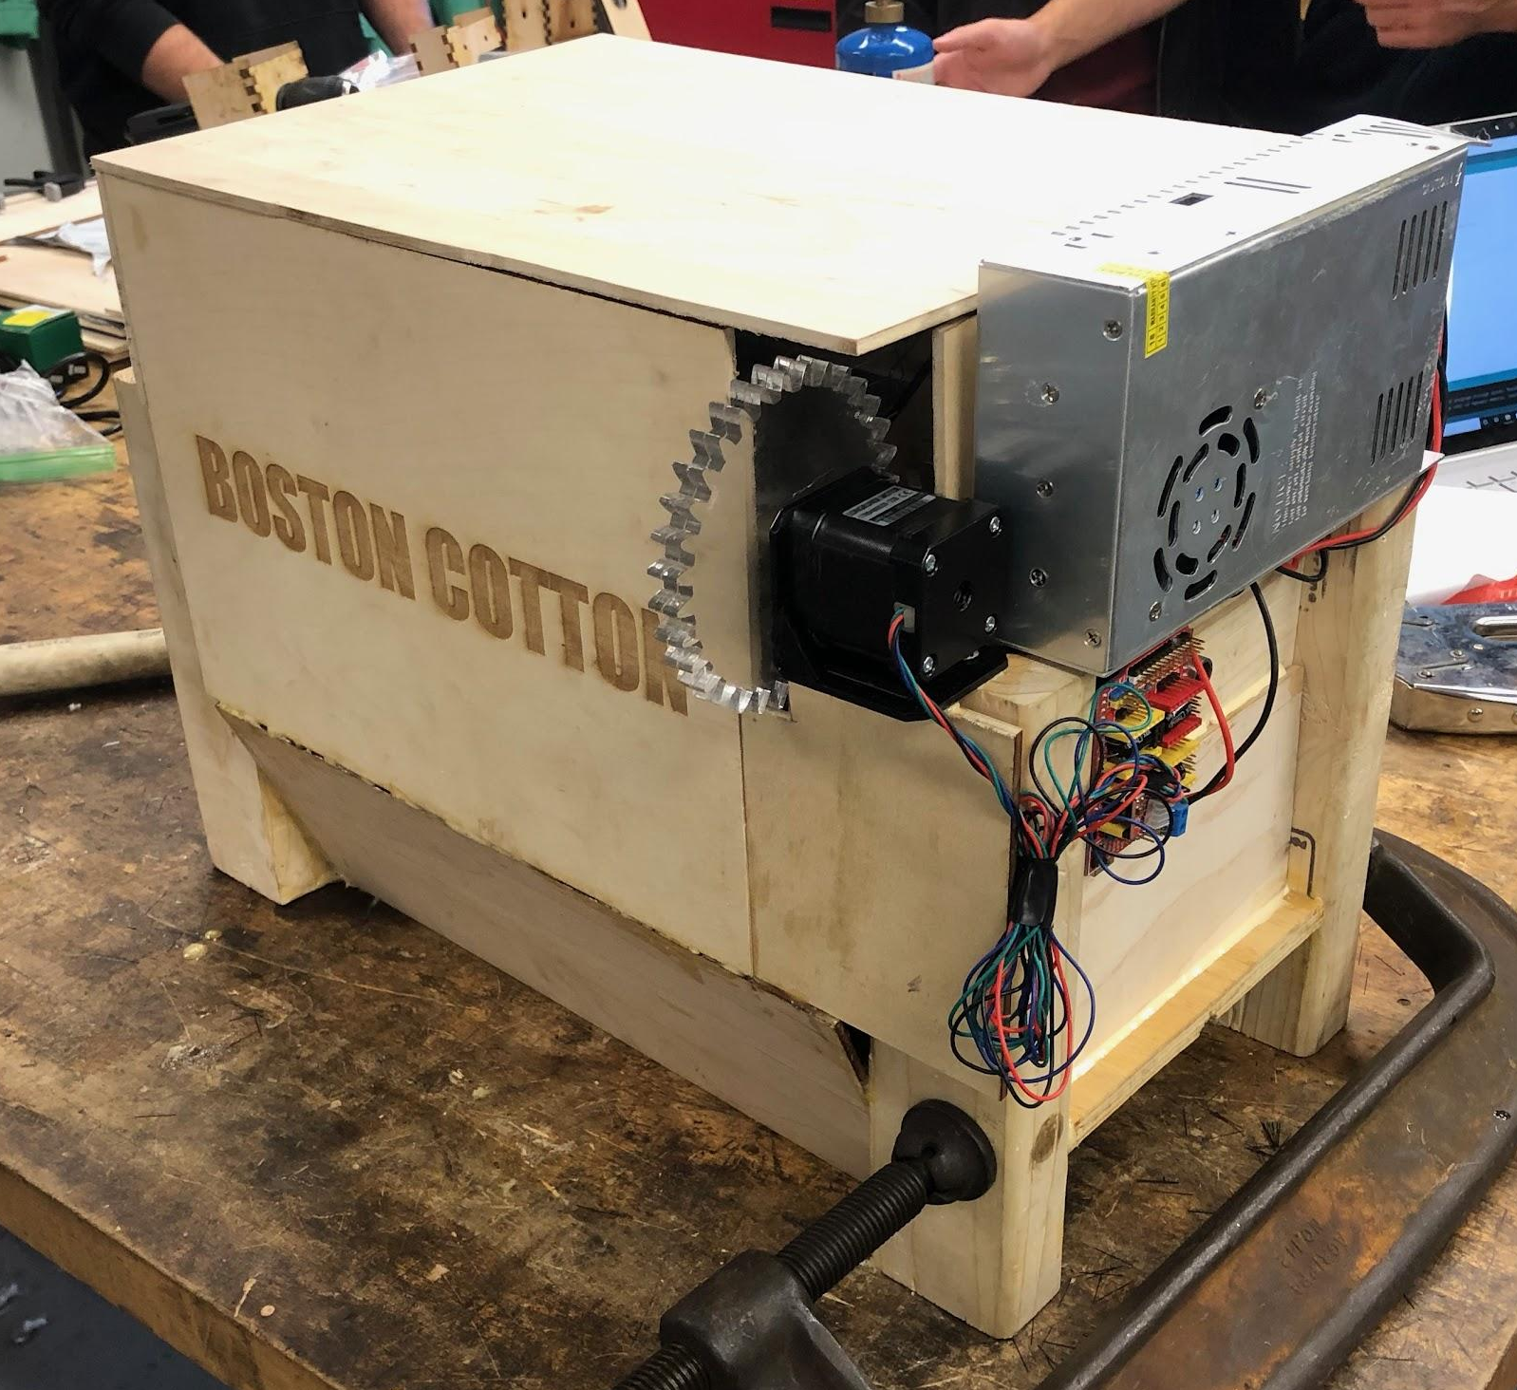
FINAL PROTOTYPE
Notes:
KYLE

Slide 12
CONCLUSIONS AND RECOMMENDATIONS
CONCLUSION
Air is a key component to getting the wispocity needed
Prototype needs to be constructed for easy modification
RECOMMENDATIONS
Use lightweight material to allow for increased rotational speed
Add rotating spokes inside tumbler that would rotate in the opposite direction
A single layer or mesh with smaller gaps
Increase pressure
Less dense brush or comb at the bottom
Notes:
NICHOLAS

Slide 13
THANK YOU! QUESTIONS?
Notes:
AMANI

Slide 14
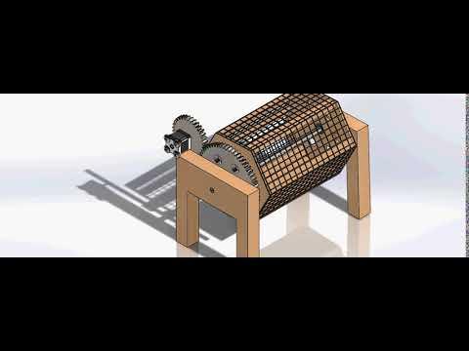
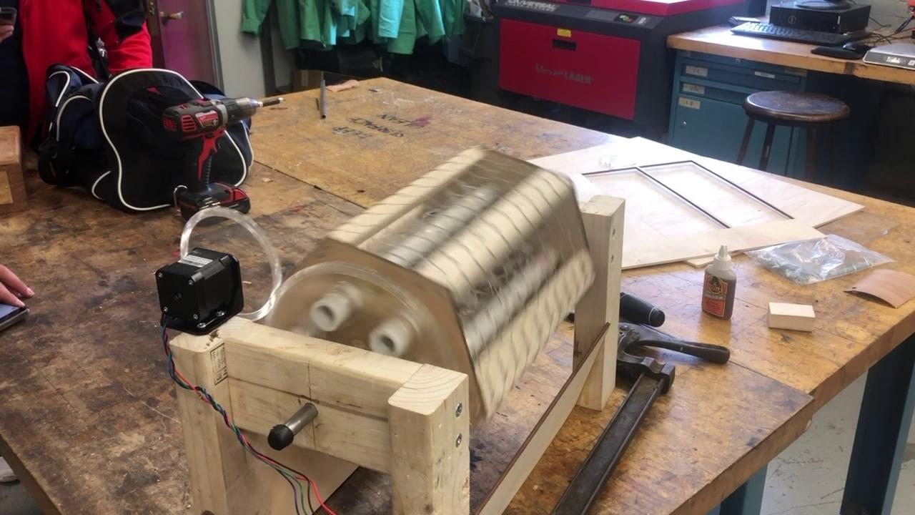
DEMONSTRATION
Notes:
NICHOLAS

